Slide 1
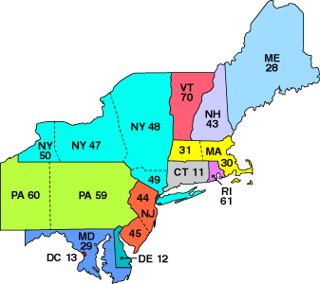

Northeast Regional AA
Service Assembly (NERAASA)
Gratitude
Humility
Ego
Obligation
Challenge
Notes:
Name, Sobriety Date, Service Commitment.
Welcome to NERAASA 2021 – the first Virtual NERAASA.
My service history entails Gratitude to Ego to Challenge to Obligation to Humility (and if You’re Lucky) and back to Gratitude.

Slide 2
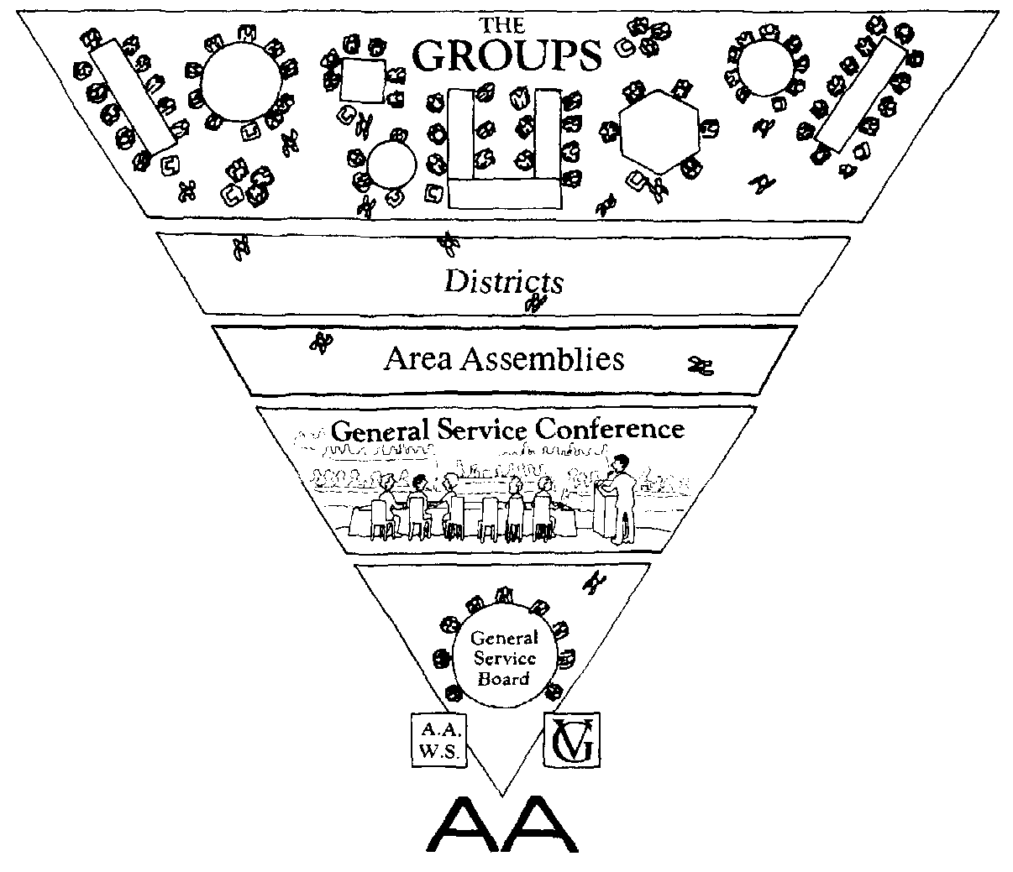
The Northeast Region
323,041 Members
15,084 Groups
18 Delegates
11 States
Notes:
Read the right side: These estimates are extracted from the e-Final Conference Report, page 11 of 14.
Do you see that arrow - that’s me. In April of 2021, I’ll sit at the table. Then, in May, I’ll spend the next two years walking away - slooooowly.
This is our Spirit of Rotation in action.

Slide 3

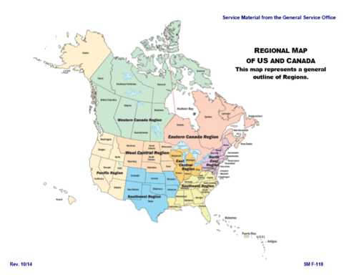
This is What it’s Like For Me
Notes:
This is what it’s like for me: There’s no rank and file – we’re all in this thing together. That’s me, the red-headed fella.
Like it says in Concept IX on page 37: “… a fine plan or idea can come from anybody, anywhere. Consequently, good leadership will often discard its own cherished plans for others that are better, and it will give credit to the source.”

Slide 4

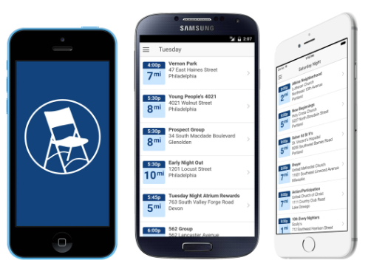


Meeting Guide APP is Being Expanded to Include Online Meetings
Notes:
Speaking of good ideas –
Technology has expanded our means to communication across all of AA, including overseas. The Technology/Communications/Service team is working with OIAA to get their meetings listed in the application. APP usage is back up to over 150,000 users.

Slide 5


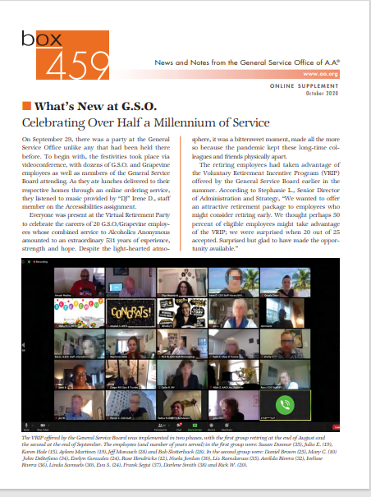
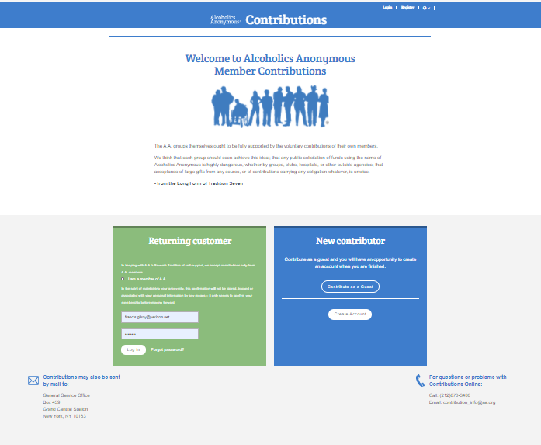
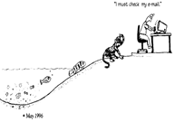
GSO’s Two Basic Functions
Publishing:
Services:
Group Records
Notes:
There is a downside to all this technology, you know.
While we’ve certainly been innovative about carrying the message, have we, perhaps, unintentionally left anyone behind?!
Have we inadvertently sacrificed effectiveness in the name of efficiency?
You just know I’m gonna get in trouble for my depiction of the Group Records function – right?!

Slide 6


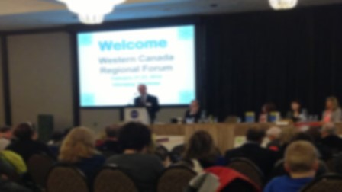

2020 Two US-Canada Forums
2021 Four Regional Forums (Possibly Eight)
2020 4-Day Conference
2021 8-Day Conference
Notes:
In December we hosted two one-day events: the East and West US-Canada Forums. A total of over 4,000 members attended (around half were first-time Forum attendees). All general sessions featuring French, Spanish, Closed Captions and ASL interpretation. The two events also attracted several international attendees, including AA members from Israel, Brazil, Spain, Sweden, and Japan.
For 2021, in addition to the four planned Regional Forums, we could have up to four “make-up Forums.”
After conducting a 4-day General Service Conference in a virtual setting, we have applied several lessons learned into this year’s schedule. Right now, we are on course for an 8-day Conference and have planned some pre-Conference meetings to help spread out the work.
Oh, that’s Vancouver, Canada by the way … the host site for the 2025 International Convention.

Slide 7

2020 Financial Highlights
Notes:
Now that I’m settled in, it’s time to talk about money.

Slide 8
2020 Financial Highlights
7th Tradition of Self-Support: $10.3 million our highest ever!
In 2019, Contributions approximated - $8.9 million.
Cost of Services to the Fellowship: $##.# million (estimated).
In 2019, the Cost of Services approximated - $11.8 million.
Reserve Fund of $12.3 million approximates 7.7 months.
In 2019, our Reserve Fund approximated 9.2 months.
Notes:
Just read.
Historically about 58% of revenue comes from literature sales and about 42% from contributions.
While in 2020, literature sales make up 37% of revenue with 63% coming from contributions.

Slide 9
7th Tradition Self-Support
2011 – 2020
Presented on February 26-28, 2021
Notes:
If you hear me refer to “The Fellowship Rally” this is the nickname for our Post-COVID 7th Tradition Contributions.
Let’s take a look at our on-line Contributions.

Slide 10

Growth of On-Line Contributions
2016 – 2020
Notes:
Since its inception in 2010, on-line Contributions have grown just under $87,000 (or 1.38%) to almost $2.2million or 21%, in 2020.
In February 2021, the Trustees Finance Committee:
Approved the 2021 G.S.O. budget, which reflects total revenues of $15,594,000, total expenses of $14,952,613 and a bottom-line surplus of $641,387
Approved the 2021 Grapevine budget, which reflects total revenues of $1,358,481 and a bottom-line deficit of $354,225
Approved the 2021 La Viña budget, which reflects total revenues of $62,968 and a bottom-line deficit of $401,790.

Slide 11
International Convention (Detroit)
Initial Amount from our Event Insurance: $ 971,092
Amount Subsequently Received: $1,181,042
Final Insurance Settlement: $2,152,134
*Amount Allocated to AA Grapevine, Inc. $ 180,000
Cost of our Event Insurance: $ 57,507
*To cover pre-Convention expenses (translation expenses, project editors, administrative support, etc.).
Notes:
Earlier, I mentioned the upcoming International Convention in Vancouver.
While I’m saddened that we had to cancel, due to COVID, I am pleased to report that we did alright financially.
We’re still sorting it all out, we refunded everyone’s money who asked for it and we fully covered all our direct expenses.
Our insurance settlement, though, had two parts: one for Direct Expenses and one for Anticipated Income.
Thus, we are in the unenviable position of cancelling our Convention but being made whole as a result.
I’ll talk more about this when we discuss our Prudent Reserve. Remember this figure: $1,181,042.

Slide 12
Reserve Fund
 | 2020 | 2019 | 2018 | 2017 | 2016
Reserved Fund – ($ in Thousands) | $12,297** | $15,900 | $15,935 | $14,353 | $14,959
Recurring Operating Expenses ($ in Thousands) | 19,076** | 20,700 | 19,736 | 18,059 | $17,410
Number of Months | 7.74 | 9.2 | 9.7 | 9.5 | 10.3
Groups | 74,949* | 68,478 | 68,478 | 66,860 | 66,336
Reserve Fund per Group | $164.07 | $232.00 | $232.71 | $214.67 | $225.50
Number of Members | 1,525,043* | 1,418,177 | 1,418,177 | 1,381,954 | 1,362,402
Reserve Fund per Member | $8.06 | $11.21 | $11.24 | $10.39 | $10.98
By Conference action, the “Prudent Operating Reserve” was defined as an amount equal to the preceding year’s combined operating expenses of AA World Services, AA Grapevine and the General Fund of the General Service Board. As such, operating expenses include “office and operating expenses” but not the Cost of Products.
Presented on February 26-28, 2021
* = SMF-53, dated December 2020
** = 2020 Reforecast 2.2
Notes:
** The 2020 figures come out with the 2020 Reforecast 2.0, as provided to Trustees Finance Committee on January 31, 2021.
* The 2020 figures come from SMF-53, dated December 2020.

Slide 13
Reserve Fund Ratio Number of Months Coverage
15-year Average = 10.04 Months
Notes:
On December 31, 2020 the Reserve Fund is 7.74. The 20-year average is around 10 months (i.e., well within a comfortable range of 9 and 12 months).
Also, although we received $1,181,042 from our event insurance settlement, detailed below, as of last night, the Board has not yet decided whether to:
put the money into our Prudent Reserve (which sounds nice),
keep the money in our operating account to promptly pay vendors (which yields purchases discounts, indicated above, which is nice),
to apply the money to our employee pension fund and/or employee medical benefits (which would be nice, going forward, as it lessens future obligations).
If we apply the entire $1,181,042 to our Prudent Reserve, we will be at approximately 8.5 months (8.48).
Has your Group ever had a meeting to discuss:
whether to replace a Coffee Pot,
or whether to add to the Prudent Reserve,
or perhaps make a Contribution to GSO?!

Slide 14

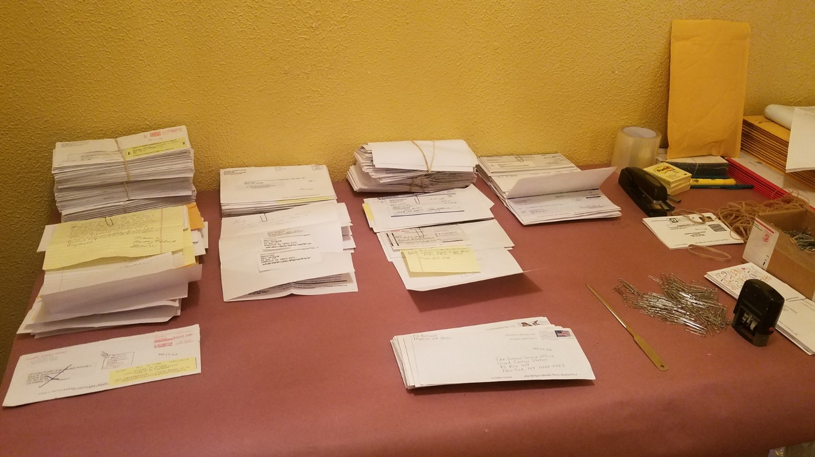
2020 Update COVID-19 Impact Carrying our Life-saving Message Continues
As a result of implementing ERP, the work continues – remotely.
Our GSO Staff ensures that our vital services are readily available throughout the Fellowship.
Virtual General Service Board and other Committee meetings are conducted remotely.
Presented on February 26-28, 2021
Notes:
You can’t stop AA - even in a pandemic!
Leveraging technology and telecommunications platforms, online meetings sprung up all over the world.
Tell the story about Aubrey and Pedro traveling to people’s homes to make sure they were connected and able to support carrying the message.
They kept the wheels on the wagon -

Slide 15

The Corona-Coaster
Notes:
As for my experience serving on the GSB, it has been a roller coaster ride.
Contributions in 2019 were at their peak while literature sales were brisk,
The long-awaited Meeting Guide APP became a reality,
Optimism permeated the General Service Board, and
The long-awaited ERP project was underway.
So, I volunteered for challenging Committee Service and set about making the most of this opportunity.
Then came:
COVID // Book Sales Declined // Virtual GSC // Cancelled the “In-Person” International // Voluntary Retirement 95 to 75.
Fellowship Rally // Virtual Forums – US and Canada // ERP includes Financial, Web Site and now Fellowship Connection (Group Services) upgrades.

Slide 16

Since Joining the Board …
Virtual
Forums
Virtual
GSC
“Reboot”
Web
Design
Meeting APP
Tremendous “Fellowship Rally”
Notes:
We evaluated our first Virtual General Service Conference and applying lessons learned to our second.
Upgrades were made to the Meeting Guide APP to accommodate Online – I can’t even keep up with them.
We completed two US-Canada Forums. Our web re-design was completed – from home!
ERP has been implemented and Registrar Training is well underway.
Overall, ERP will reduce labor costs and streamline processes required to support the Fellowship.
A tribute to our GSO Staffs, AAGV, Executives, and “Tradition 8” Service Workers – working from home!

Slide 17


Other Good News Stories
Languages: To date, AAWS copyrighted literature is translated into 110 languages.
The “Big Book” is available in no less than 73 languages, including the original English,
most recently: Russia (Tatar) and India (Oriya).
This year, the International Convention’s souvenir book was released on February 14th.
See also https://onlineliterature.aa.org .
Presented on February 26-28, 2021
Notes:
What are we doing with your money …
Last year, 102 languages. Last year, 71 languages.
Our Great Responsibility” has sold over 43,000 copies (since its May 9, 2019 release) while adding nearly $40,000 of gross sales revenue. Per our Publishing Director: “From a strictly finance P&L standpoint: all editorial, translation, production and printing costs were all covered and far surpassed by sales revenue prior to year-end 2020.

Slide 18





2020 Grapevine Highlights
Chris C., a former AAWS Publishing Director and collaborator on several Grapevine projects, is currently the Acting Publisher for our AA Grapevine and La Viña (AAGV/LV).
AAGV/LV have signed several “tablet” vendor contracts. At present, we are working with Correction and Hospital & Institutions Committees to upload our literature on those tablets.
AAGV/LV have been seeing our book sales increase at a steady pace. However, at present, we’re nowhere near our 2019 levels.
Notes:
Ingram CoreSource Plus, setting up distribution with 38 major eBook platforms (including Amazon, Apple, B&N, Kobo, Google Play books, BibliU, Hoopla, Libreka, Libri, Mackin Education, Scribd, and Overdrive0: as well as 13 major audiobook vendors, including Audio Apple, Audible, Audio Kobo, Audio Google Play, Hummingbird, and Storytel.

Slide 19
Grapevine Average Circulation: 5-Year History
Notes:
We made the online Grapevine available at no charge throughout the Spring and early Summer, and our internet visits skyrocketed!
GV Magazine Actual: 63,397; Budgeted: 67,802
GV Online Actual: 3,558; Budgeted: 4,046
GV APP or ePub: 1,617; No Budgeted Amount.

Slide 20
La Viña Circulation: 2005-2020
15-year Average = 9,708 Issues
Notes:
The subscription levels for our Spanish language magazine, La Viña, for the last 15 years, with 2020 having average magazine subscriptions of 9,708.
One of the reasons for this steep drop is the cancellation of large-scale Spanish events throughout 2020.

Slide 21

2020 Grapevine Highlights
AAGV/LV YouTube is seeing new subscribers each month. We have resumed collecting audio stories for YouTube or possibly even podcasts.
AAGV/LV “Carry the Message” Project (a monthly Twelve Step call to those seeking our help) sold almost 5,000 subscriptions throughout 2020.
Two New Books: “Free on the Inside” and “Voices of Women” in Spanish will, ideally, be ready for our 71st General Service Conference.
Submit articles to: www.aagrapevine.org/contribute
Notes:
Just read.
This year, La Viña is celebrating its 25th Anniversary (July/August issue)!

Slide 22


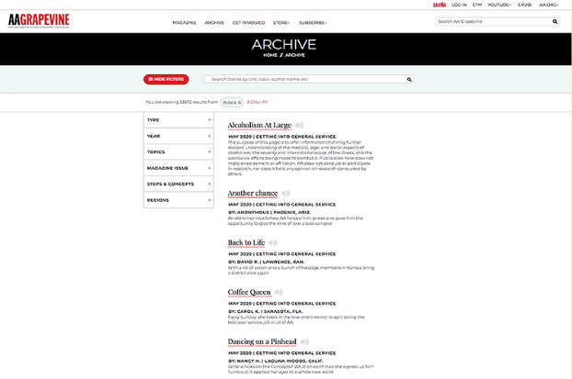
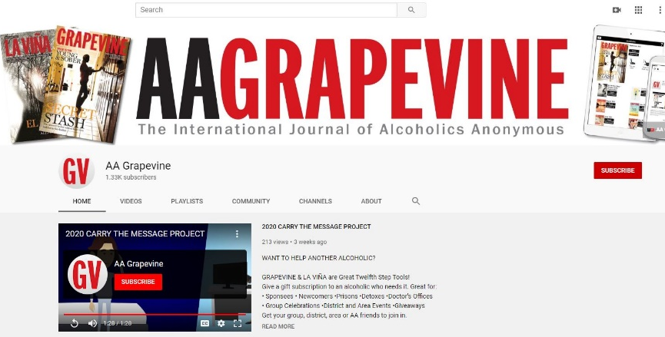

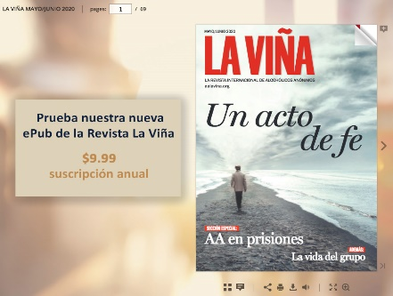


AA Grapevine on YouTube
Digital
Archive
eBooks, Audiobooks
Grapevine Daily and
La Viña Weekly Quote(s)
We Also Have ePubs
Notes:
YouTube videos are currently available in English and Spanish, with more on the way.
There are short stories read by the actual author with a backdrop photograph submitted by a member.
Several explainer videos have been added, including “Carry the Message” and “How to be a GVR or RLV.”
While we’re still the International Journal of Alcoholics Anonymous, we’re now also the Voice of AA!

Slide 23



What Can I Do Right Now – with no Further Obligation?
Sign up to receive Grapevine Daily Quote!
Go to www.aagrapevine.org and Type “Daily Quote” in the Search Bar
Presented on February 26-28, 2021
Notes:
If you are interested, Go to www.aagrapevine.org and Type “Daily Quote” in the Search Bar
With relatively little effort, you can sign up to receive a free Quote of the Day – starting today!

Slide 24

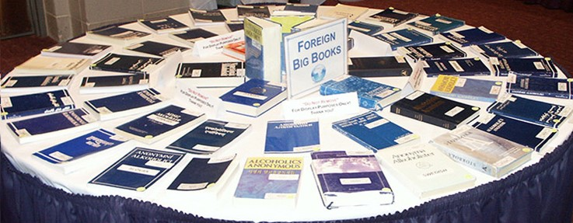
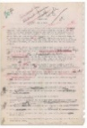
Intergroups and Central Offices
Notes:
As a part of my Board Service, I’m in tune with:
Literature Sales,
Meeting lists and Newsletters,
Telephone Hotline Service , and the like.
This year, I participated in the 35th Intergroup Central Office of AA Seminar: “Participate But Don’t Obligate!”
Also, I facilitated one of the US-Canada Forum Panels with Intergroups and Central Offices.
When I lived on Long Island, I served on the Finance Committee as well as Treasurer.
Calling the Hotline and talking with the Volunteers.

Slide 25
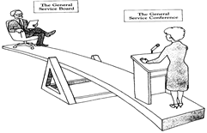
Trustees’ Fiduciary Duties
Duty of Care:
Attend meetings,
Come prepared, and
Follow-up on action items.
Duty of Loyalty:
Undivided allegiance, and
In the best interests of AA.
Duty of Obedience:
Faithfulness to the organization’s mission.
Notes:
Read through.
NY Not-for-Profit Corporation Law [major rewrite in 2013, with amendments in 2016, called the New York Nonprofit Revitalization Act (Section 717)] as well as IRS laws for nonprofits. Our required duties include but are not limited to the obligation to do an annual audit, abide conflict of interest rules, and many other corporate obligations including financial reporting.
It’s about faithfulness to the mission – “To serve the Fellowship of Alcoholics Anonymous.”
Which brings us back to why we’re here –
The people are the mission – not the structure!
This picture is from The Twelve Concepts for World Service (Illustrated), P-8.
For extra credit: Does anyone know why I do not like this picture?

Slide 26
How It Works - Trustees’ Committees
Archives
Audit
Compensation
Conference
Corrections
CPC / Treatment / Access & Remote
Finance & Budget
General Sharing Session
International
International Convention and Regional Forums
Literature
Nominating
Public Information
“ad hoc” Finance Advisory Team
Notes:
Archives - Chair Finance & Budget – Vice Chair Grapevine – Vice Chair, Next Year’s Treasurer Nominating, Licensing, and Bylaws

Slide 27
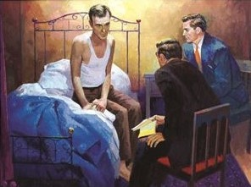
Remember the Connection …
Notes:
As my predecessor shared with me, I will share with you:
As you conduct your “Service Beyond the Home Group,” try to remember the connection between what you do and the Newcomer.

